Slide 1
Technical and Hardware Details for Crawler4j, Apache Nutch, StormCrawler and Heritrix

Slide 2
Table of Contents
Introduction to StormCrawler, Crawler4j, Heritrix and Apache Nutch
Technical Features – Politeness, Parallelization, Selection Policy, Revisit Policy.
Architecture
Installation and System Requirements.
Configurations and Usage Feasibility

Slide 3
StormCrawler, Apache Nutch, Crawler4j and Heritrix
All are web based Crawler open source tools.
StormCrawler: StormCrawler is an open source SDK for building distributed web crawlers based on Apache Storm. It has organized into two sub-projects
Core(sc-core): Components and utilities needed by all crawler apps.
External (sc-external): Components that depend on external technologies (Elastic Search and plug-ins.)
Apache Nutch: Apache Nutch is a highly extensible and scalable open source web crawler software project.
Crawler4j : Crawler4J is an open source web crawler for java. It distributes under Apache 2.0 license.
Heritrix: Heritrix is a web crawler designed for web archiving. It was written by the Internet Archive. It is available under a free software license and written in Java. The main interface is accessible using a web browser, and there is a command-line tool that can optionally be used to initiate crawls.

Slide 4
Technical Features
StormCrawler: Storm Components (spouts & bolts) that handle primary web crawling opeations:
Fetching, Parsing and Indexing and supports parallelization.
Some of the code has been borrowed from Apache Nutch.
It helps the web crawlers that are Scalable, resilient, low-latency, easy to extend, polite yet efficient.
Apache Nutch : It supports management of recrawls, revisit policy.
It has web interface for quering the index, selection policy
It mainly functions on 4 components :
Crawler, WebDB, Indexer,Searcher (Crawler and Searcher are independent)
Plugin based architecture
Crawler4j: It is efficiently designed to crawl domains very fast.
It has politeness (The domain read speed and time delay can be adjusted)
It has revisit policy, even read the binary content from the domain.
Heritrix: It is a complete UI based crawling system.
It has politeness, revisit policy, selection policy not applicable.

Slide 5
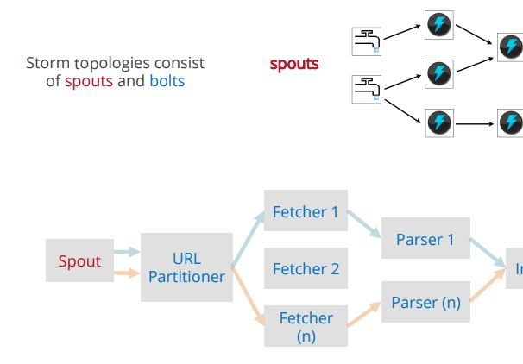
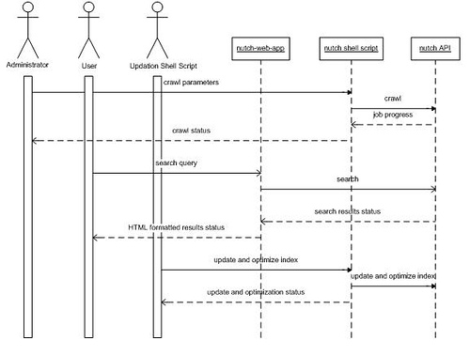
Architecture
StormCrawler:
Apache Nutch:

Slide 6
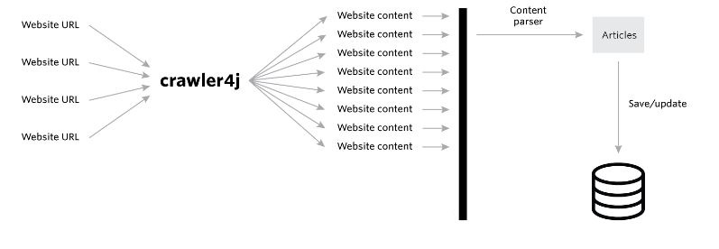
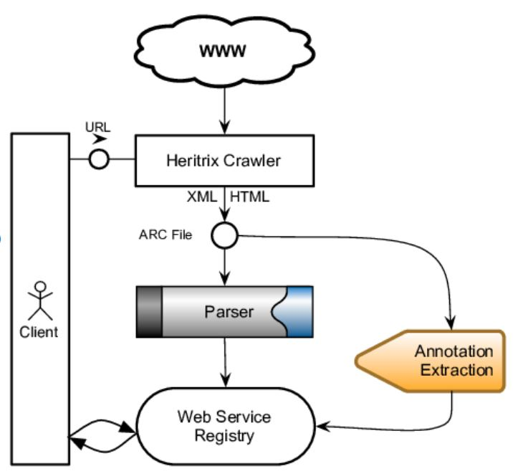
Architecture
Crawler4j
Heritrix

Slide 7
Installation and System Requirements
StormCrawler:
Operating System : Linux based OS with Command Line Interface (CLI)
Memory required : 8GB (Minimum)
System Core : 2 with port 9200, 8443, 5044
Installation/Configuration time : 30 min
Internet connectivity with high speed data transfer.
Apache Nutch:
Operating System: Linux based OS with CLI
Memory required : 8GB (Minimum)
System Core : 1-3 with localhost ports 9200/8080
Installation/Configuration time : 15-20 min
Internet connectivity with high speed data transfer
Crawler4j
Operating System : Linux/Windows OS with GUI and CLI (Linux)
Memory required : 4GB (Minimum)
Installation/Configuration time : 30 min
Internet connectivity with high speed data transfer.
Heritrix:
Operating System : Linux based OS with CLI
Memory required : 1024 MB (JAVA_OPTS) and physical memory : 4GB (Minimum)
Installation/Configuration : 15-20 mins
Internet Connectivity with high speed data transfer

Slide 8
Configuration and Usage feasibility
Storm Crawler :
Performance : It depends on the sleep time while running the crawl. Discovered 500 urls and fetched about 1000 docs for the sleep time of 864000 seconds.
First the url is discovered and then the data/content is fetched.
Programming Language : Java
Support: Recent release1.16 (Jan 2020). Very rare Github Support.
Installation procedure : Not user-friendly, complicated.
System Utilization : Full memory in usage, JVM memory utilization has to be monitored.
Apache Nutch :
Performance : The crawl function has to be initiated, then the basic commands for the fetching, parsing, indexing can be done.
The content as well as urls are fetched based on the top rated pages. Single crawl fetched about 1500 pages until the memory was exhausted. Depth can be assigned for the content that needs to be fetched.
Programming Language : Java
Support: Recent release Nutch 2.4 (October 2019). Very rare Github Support
Installation procedure : Not user-friendly, complicated.
System Utilization: Full usage of memory and JVM memory.

Slide 9
Configuration and Usage Feasibility
Crawler4j :
Performance: Single crawl pages – 3200 urls crawled with duration of 30 mins on a single crawl.
Programming language: Java
Installation Procedure : Eclipse IDE Juno and kepler with proper dependency.
Support : Github support available but very rare.
System Utilization : Physical memory and the internet bandwidth is consumed.
Heritrix:
Performance : Single crawl, url count: 1500+ (approx. as still crawling). Very slow latency of crawling.
Programming language : Java
Installation Procedure : Source code extraction and CLI based operations.
Support: No proper support available for the queries. Release of Heritrix 3.4 (April 2019).
System Utilization : Java OPTS memory has to be configured for the smooth crawl.

Slide 10
Overall Comparison of Crawlers
Features | Crawler4j | Heritrix | StormCrawler | Apache Nutch
Politeness | Yes (Configurable) | Yes (Configurable) | Yes | Yes
Selection Policy | No | No | Yes | Yes
Revisit Policy | No | No | Yes | Yes
Support (Github and others) | Medium | Medium | Medium | Medium
Code Usability | Moderate | Moderate | Hard | Moderate
Language | Java | Java | Java | Java
Performance | Very Fast | Very Slow | Medium | Medium
Crawl Results | 3000 urls in 30 mins | 2000+ so far | 500 (Urls) 770 (Docs) Fetched | 1400 + urls found with content
Note:
Scalable :The crawler architecture should permit scaling up the crawl rate by adding extra machines and bandwidth.
Performance : The classification is based on the speed of crawling.
Politeness: Avoidance of overloading of Web Sites.
Revisit Policy : States when to check for changes to the pages
Selection Policy : Ability to select the pages to download.

